Slide 1
Senior Project Literature Review
Sheela Ahmed

Slide 2

Main Objectives for Project
Emphasis on Analysis
Object detection
Creating a database of images to compare
Method of classifying objects
SIFT
Histograms
X-Y coordinate

Slide 3
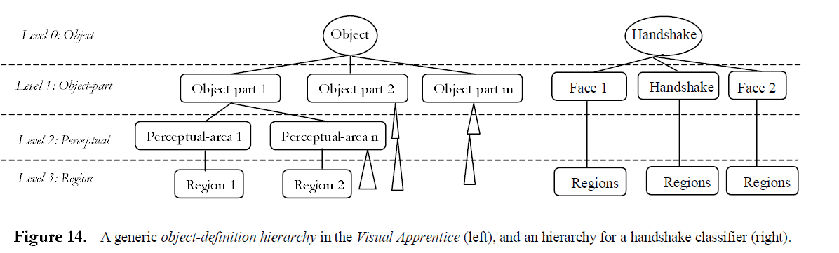
Using Human Observers’ Eye Movements in Automatic Image Classifiers, 2001
Alejandro Jaimes, Jeff Pelz, Tim Grabowski, Jason Babock and Shih-Fu Chang
Develop automatic image classification by exploring how people look at images of different semantic categories
Handshake, landscape, crowds
Visual Apprentice
Object definition hierarchy
User input to label frames and regions
Feature vectors (color, texture)
nearest neighbor

Slide 4
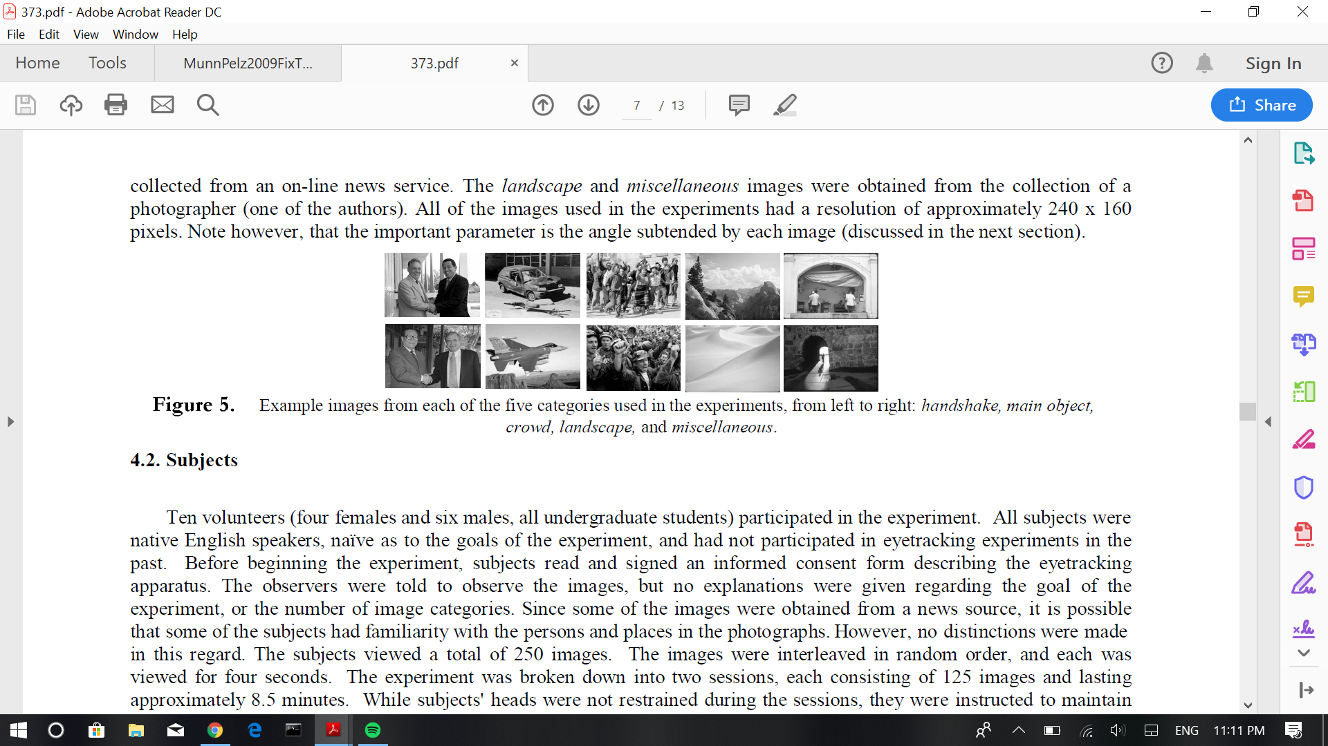
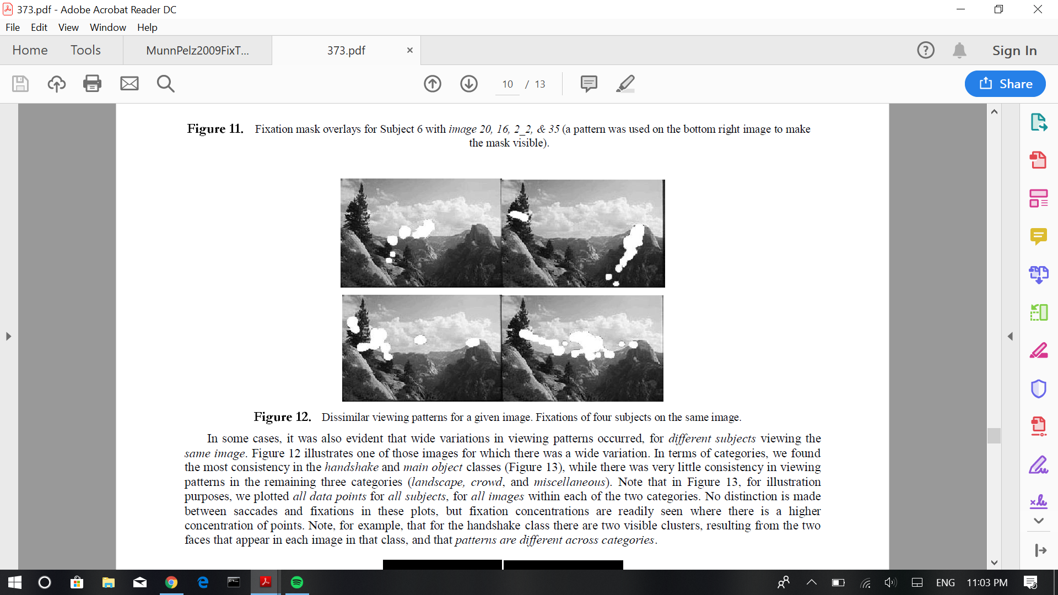
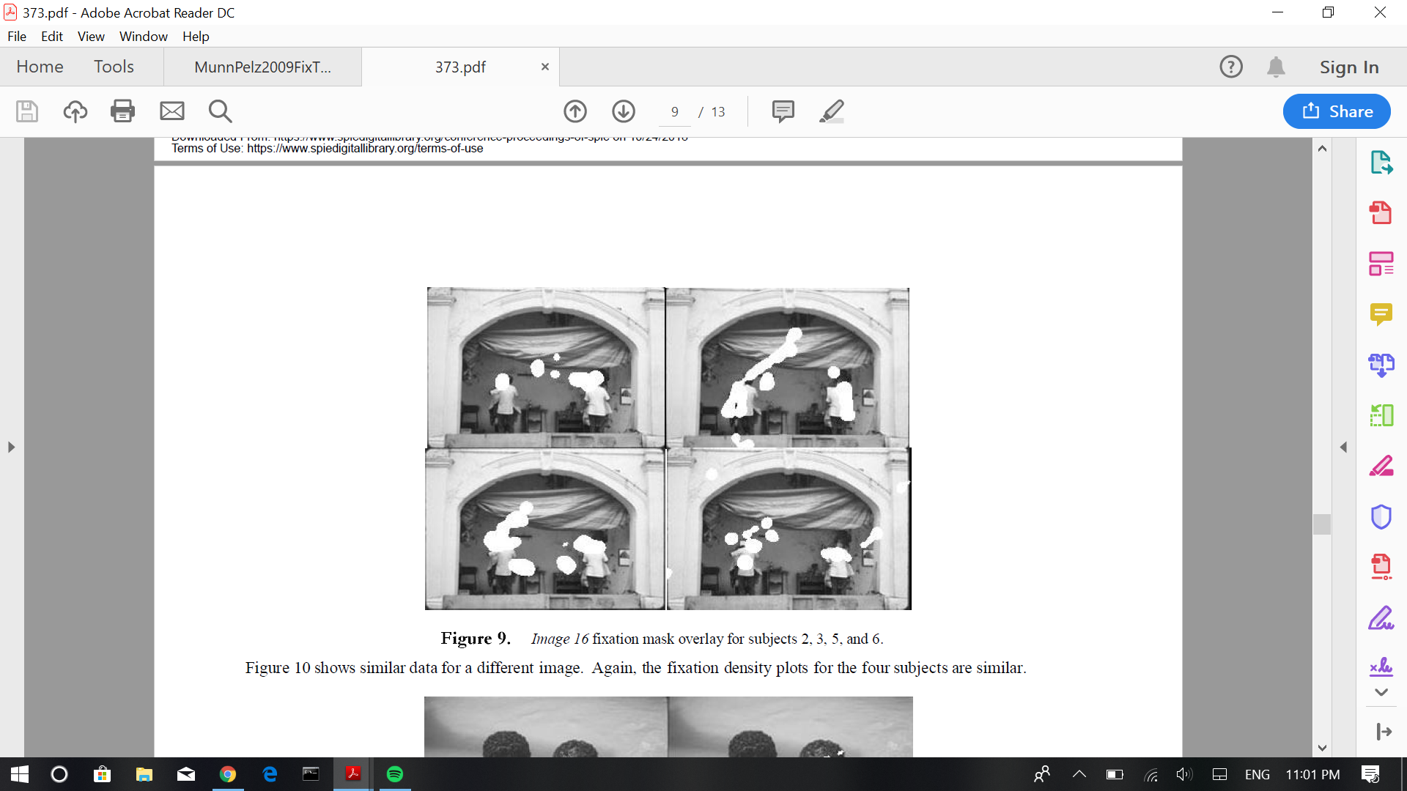

Slide 5
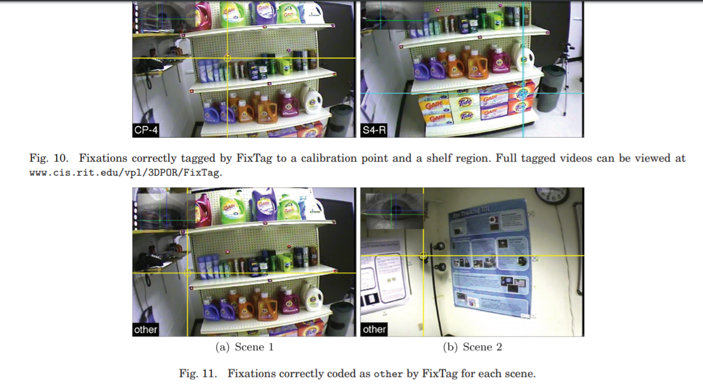
FixTag, 2009
Susan Munn and Jeff Pelz
Automatic identification of fixations
Tag each fixation to an ROI
Requires 3D positions of vertices of ROIs and calibration of scene camera
Camera projection matrices → 3D ROI vertices → POR matched to closes keyframe → 2D projected ROI vertices
requires a manual calibration of 8 reference points in selected keyframes
establish a reference for the tracking.
Notes:
FixTag: An Algorithm for Identifying and Tagging Fixations to Simplify the Analysis of Data Collected by Portable Eye Trackers

Slide 6
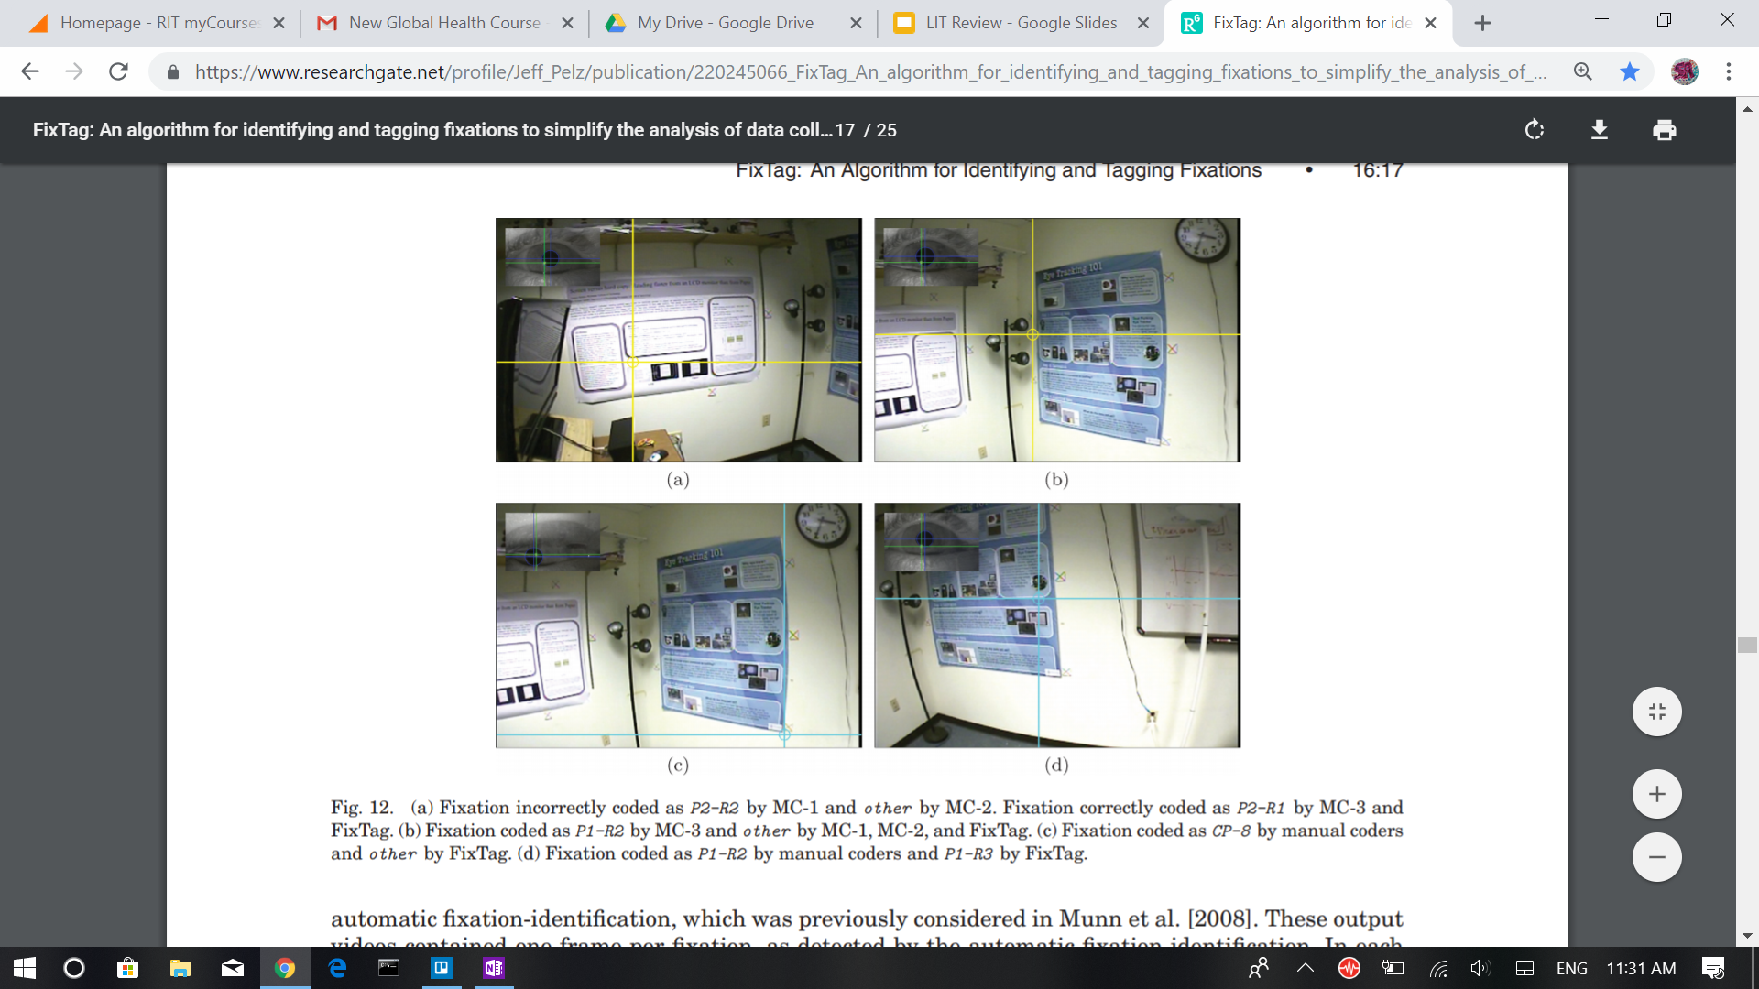
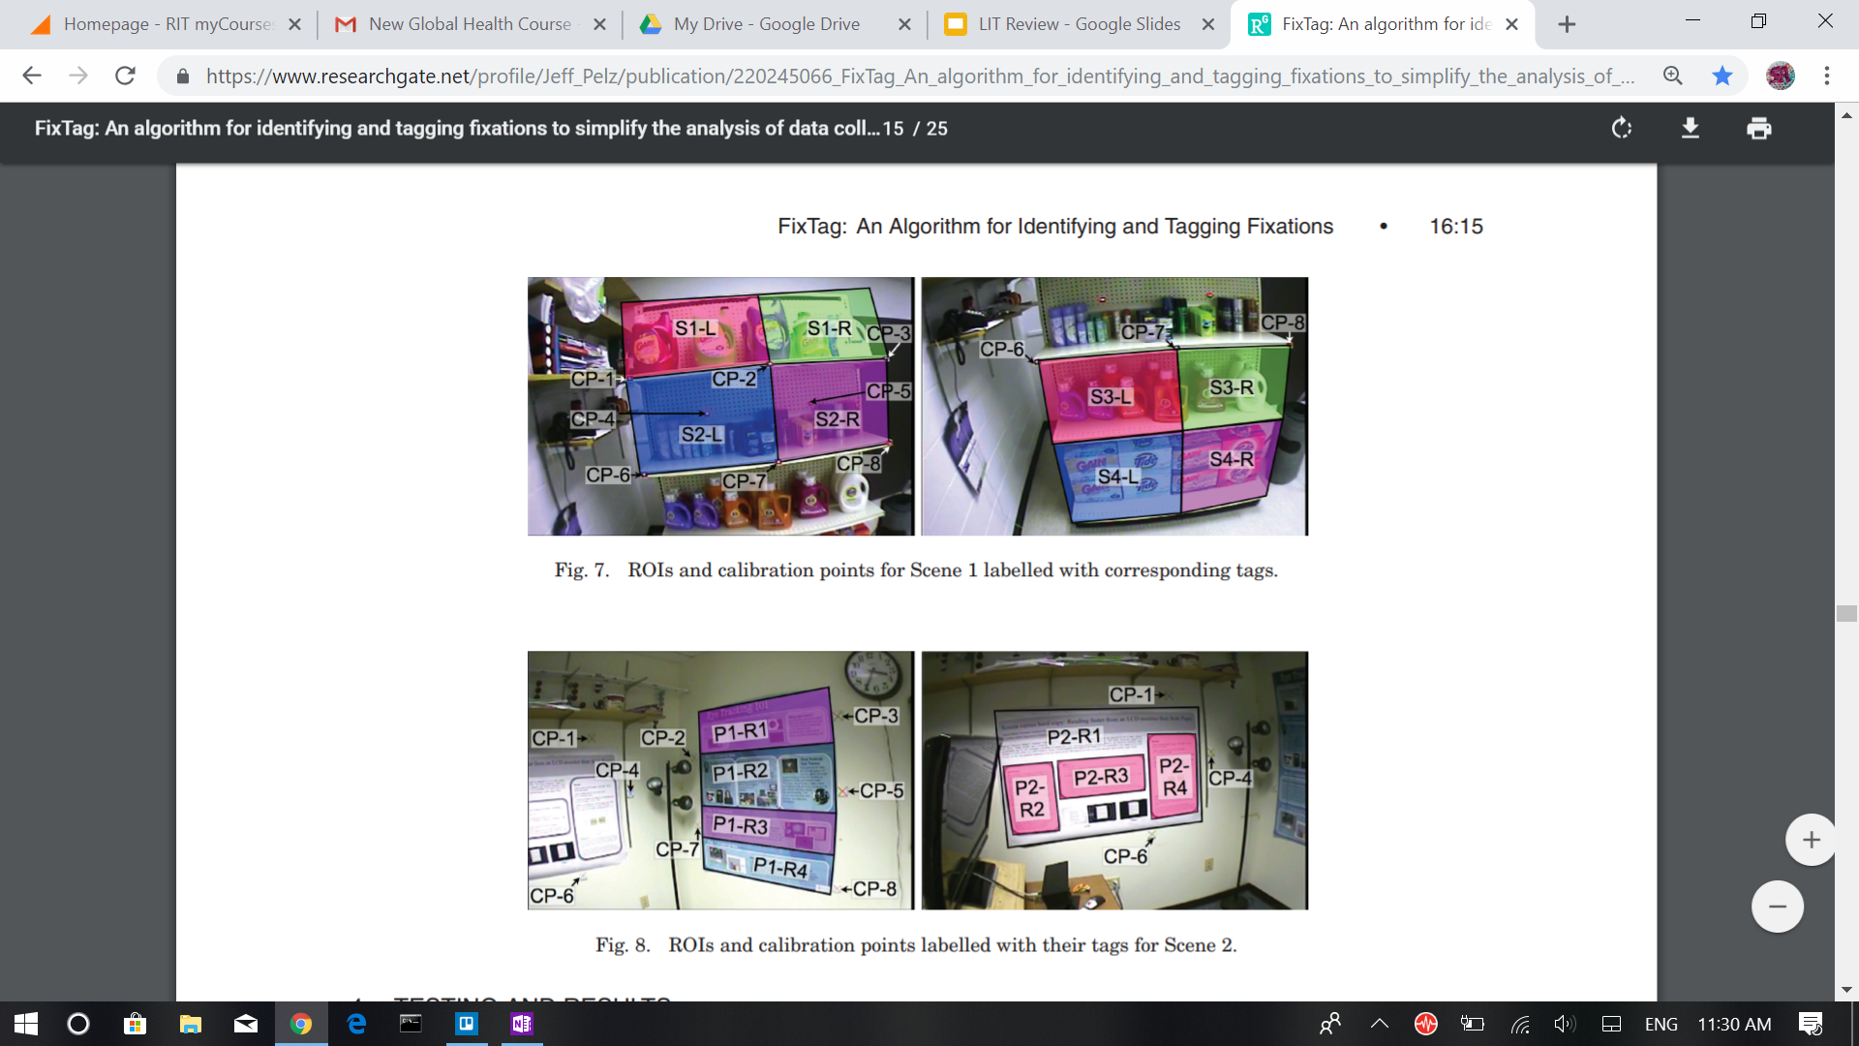
Notes:
Illustrations of fixtag

Slide 7
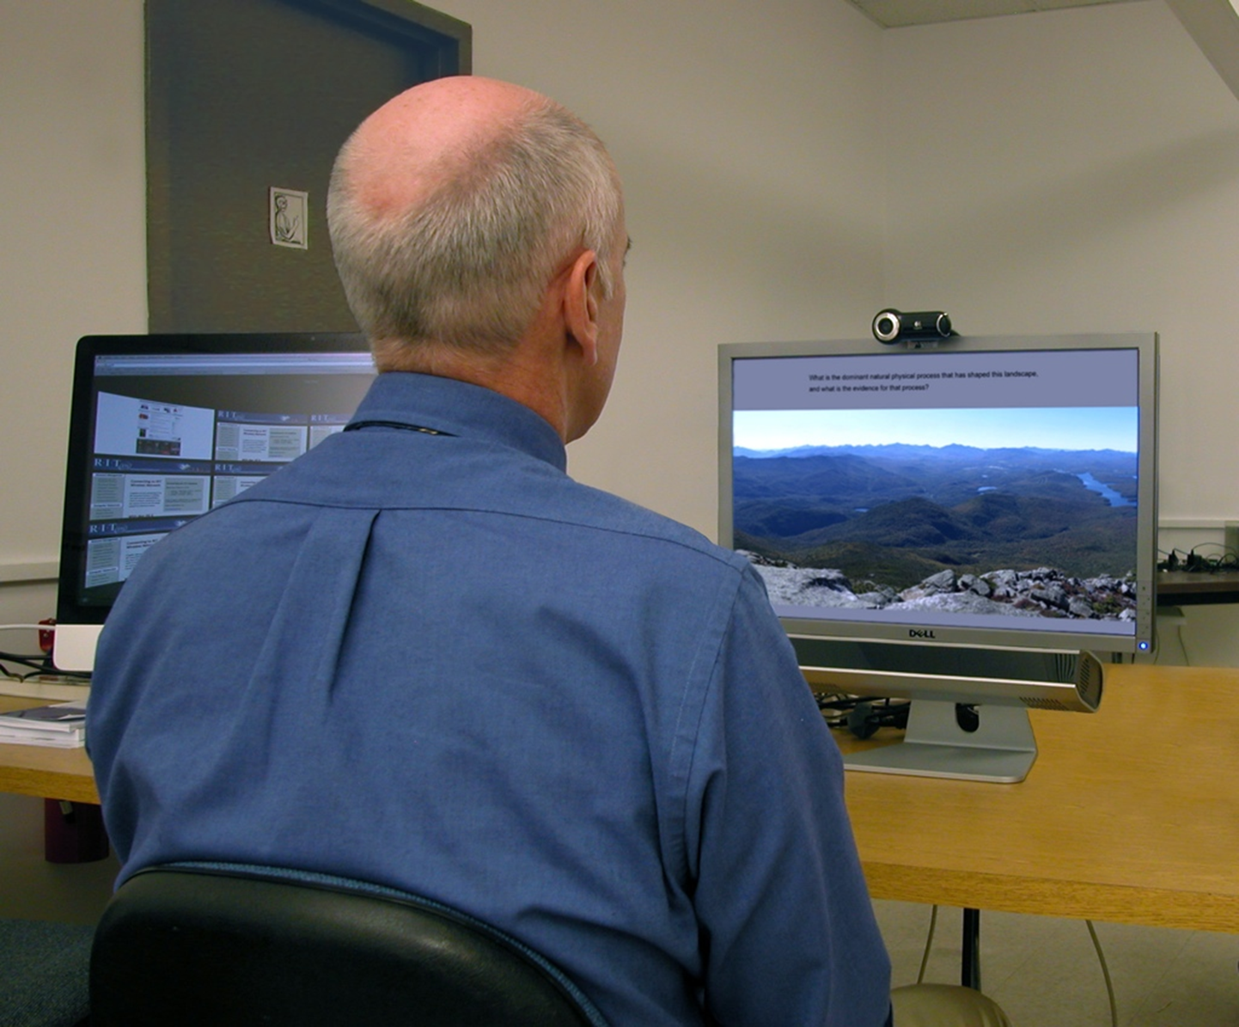

Slide 8


Analyzing Video-based Gaze Data

Slide 9
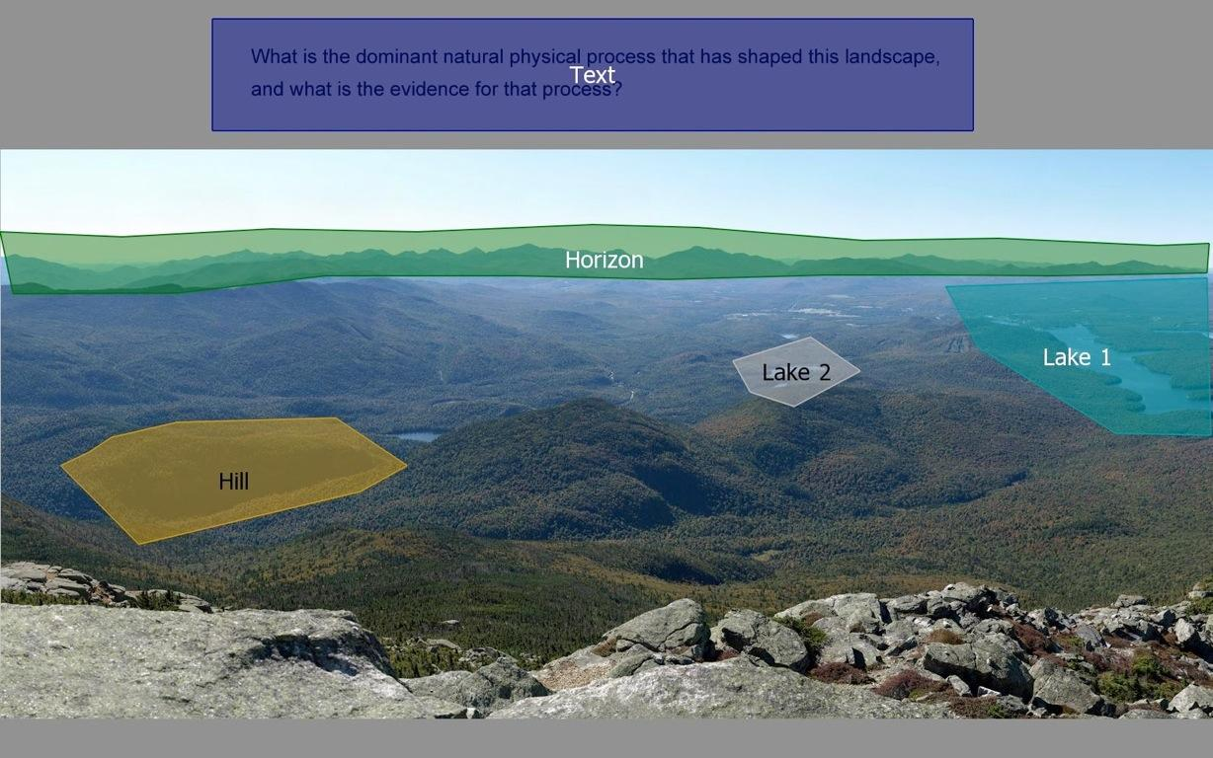

Slide 10
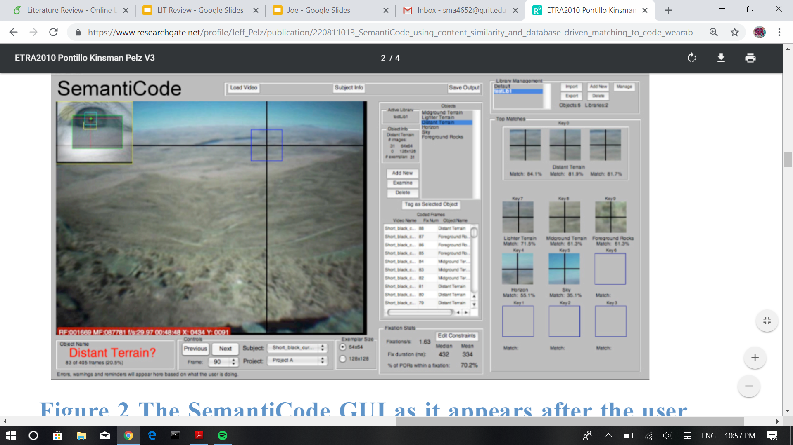
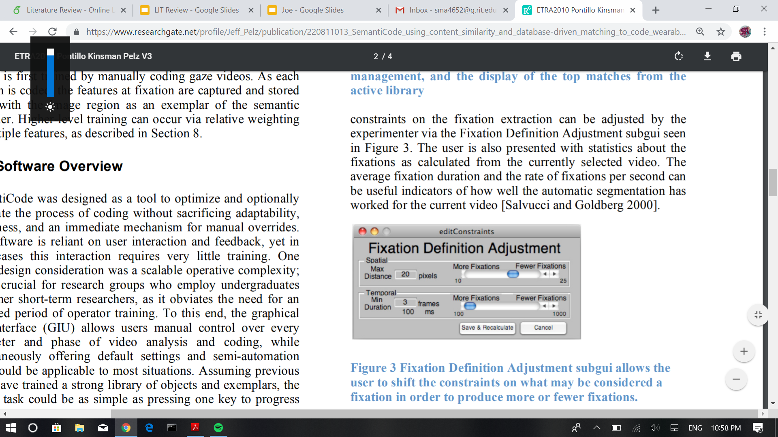
SemantiCode, 2010
Daniel Pontillo, Thomas Kinsman, and Jeff Pelz
Objective: create an object-recognition system that incorporated fixations and visual libraries to identify objects and regions
Involves GUI
Start with empty library and build it up using frames of interest
Algorithm independent of shape/spatial configuration → no need to separate object from background
Now called GazeTag and sold by some rich company
Notes:
SemantiCode: Using Content Similarity and Database-Driven Matching to Code Wearable Eyetracker Gaze Data

Slide 11
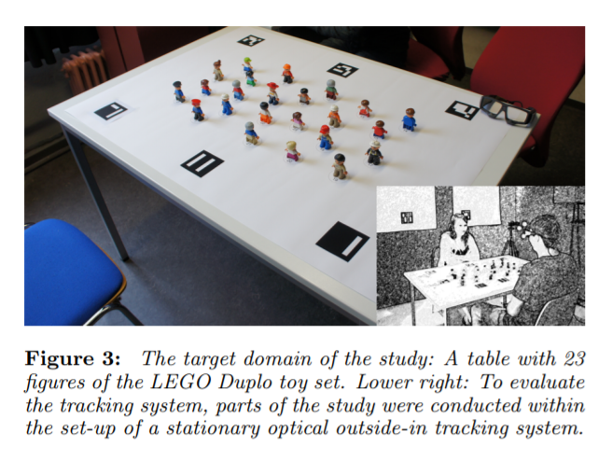
EyeSee3D, 2014
Thies Pfeiffer, and Patrick Renner
Minimize the need for user input when detecting objects in fixations
Visual marker-tracking technology
3D geometric approximations of the objects
support multiple perspectives and perspective shifts of the participants
Distinct markers are defined in the real world and tracked
Notes:
EyeSee3D: A Low-Cost Approach for Analyzing Mobile 3D Eye Tracking Data Using Computer Vision and Augmented Reality Technology

Slide 12
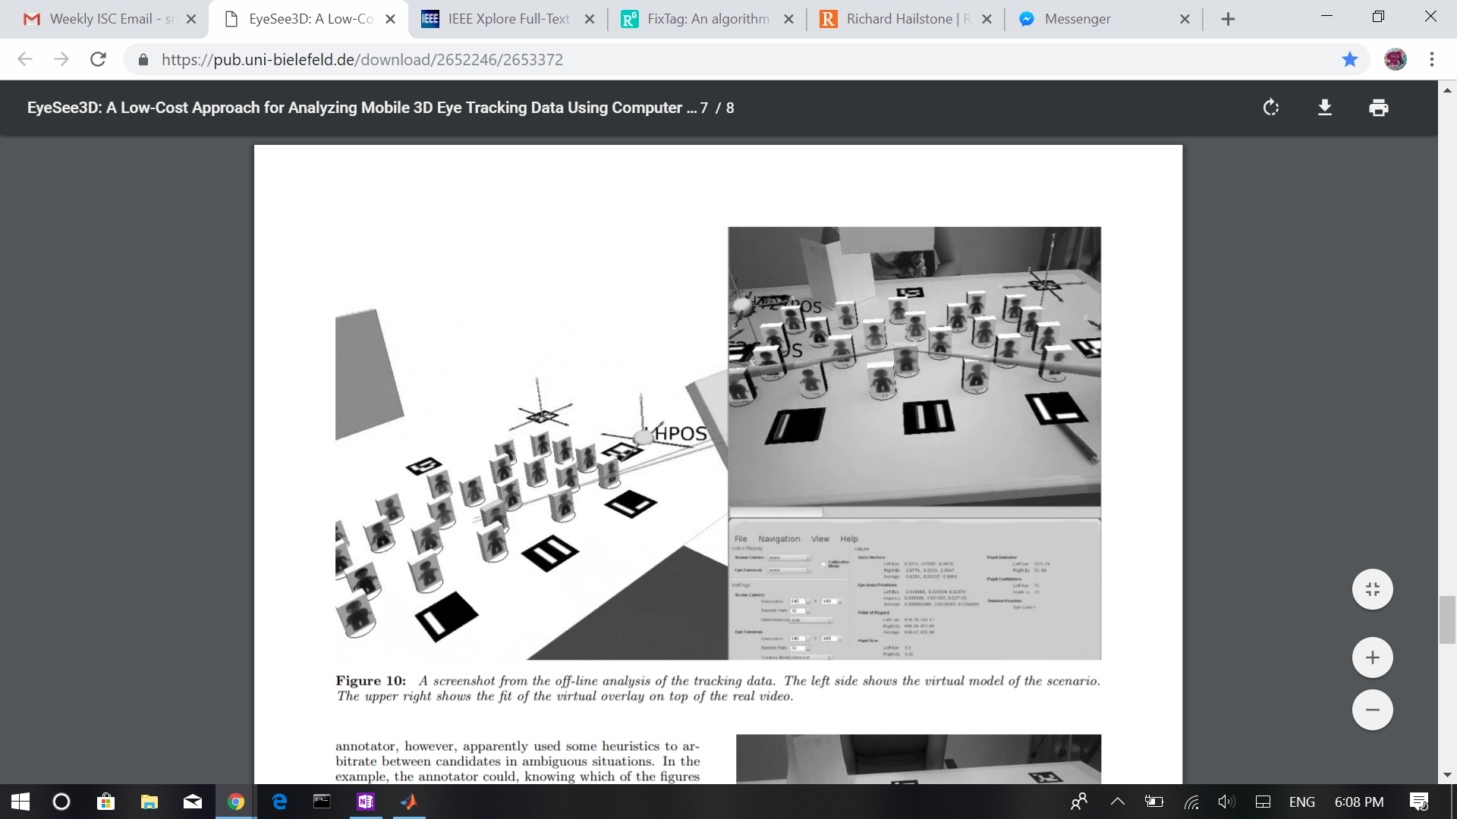
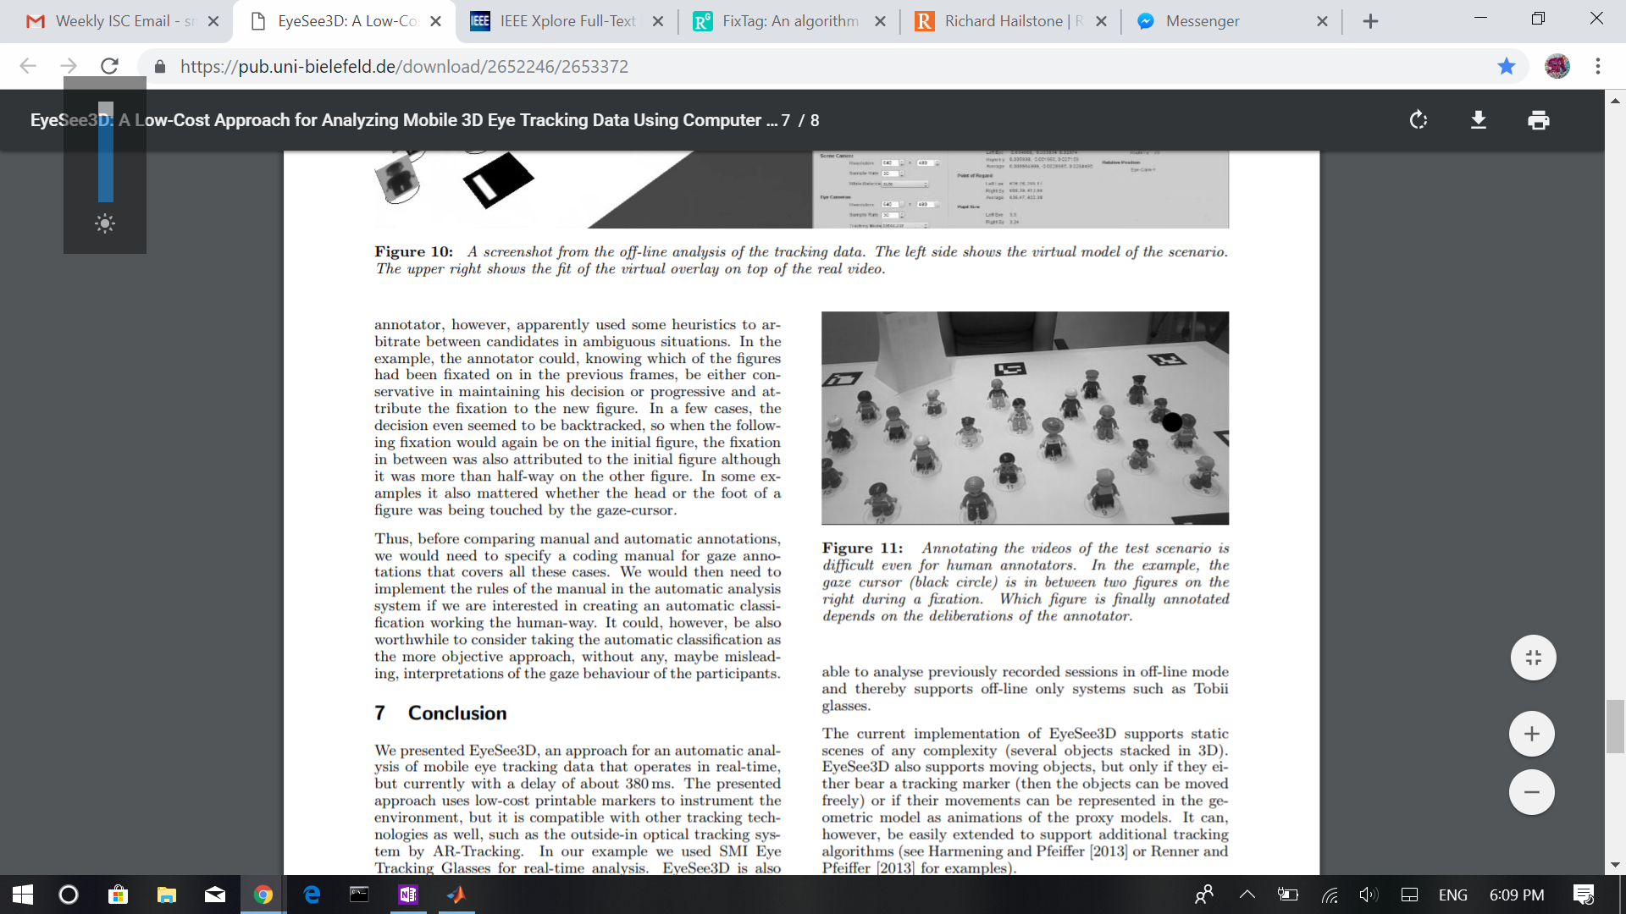

Slide 13
More previous work to research
One or two papers solely on eye tracking
Testing various eye trackers
More object detection methods
Different approaches
Extensions from papers previously read

Slide 14
Questions?

